Slide 1



HealthCoach
Created By:
Sarah Flaherty, Alyssa Schilke, Jen Moutenot, Chiara Maalouf

Slide 2


Inspiration
Incorporating our technology (we are Computer Science students after all) into our health and exercise habits!

Slide 3



Goal
To tackle the health crisis amongst the United States
To create a platform that provides clearer and trusted insights, positive health outcomes, and smarter decisions
Generate a voice activation health coach that requires limited effort and equipment

Slide 4


Responsibilities of HealthCoach
Boost self-confidence
Provide fitness and health knowledge
Advise specific workouts to do
Cardio
Abs
Upper Body
Lower Body
Strive to improve achievement drive
Spread optimism

Slide 5
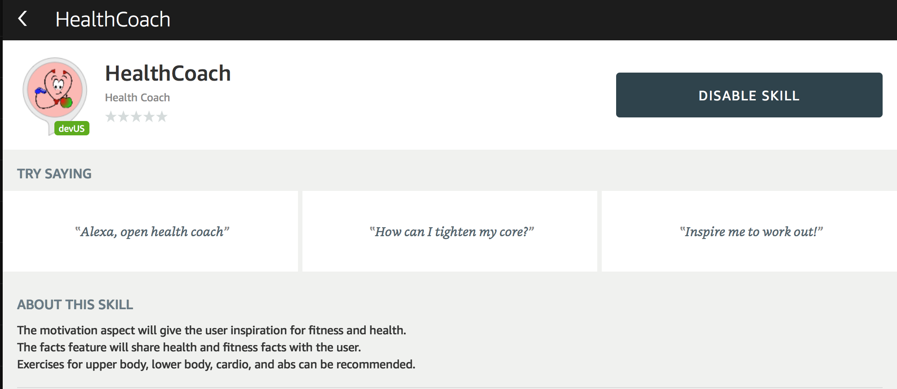

Slide 6

The Plan
1. Researching Amazon Web Services and Alexa Skill Developer
2. Test Driven Development:
Using the Alexa Skill developer creating commands:
a) Exercise Options: cardio, upper body, lower body, abs
b) Motivation
c) Health Facts
3. Connect AWS Lambda code (.js) to the Skill Developer
4. Test!

Slide 7



Plans for the Future
To display the user’s health data based on exercise, food intake, and medicine.
provide this data using graphs
To program a unique and special curated music playlist geared toward health and fitness, different from the one Alexa can already do

Slide 8


Testing
Voice User Interface
Interaction Model
Alexa Simulator
Manual JSON
Voice & Tone
Lambda Testing
Beta Testing
Demo!

Slide 9
We are proud to introduce:
HealthCoach

Slide 10

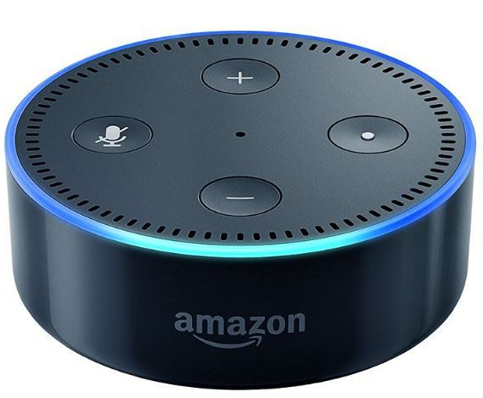
Result
"Alexa, open Health Coach"
"Welcome to the Health Coach skill! ..."

